Slide 1
A Complete guide to Summer 2016 Registration Once you’re logged into WyoRecords Click on Registration
*Slides will forward after 6 seconds or by mouse click.

Slide 2
You’ll be redirected to this page. Click on Register for Classes.
Register for Classes – Search and Register for an upcoming semester
Browse Classes – Search Only, registration not available through this link
Browse Course Catalog – Catalog search only, semester schedule not available through this link
Prepare for Registration – Clear any outstanding holds related to registration
Plan Ahead – Make a plan for registration prior to your registration date and time
View Registration Information – View past and current registration details

Slide 3
You may be asked to choose a role if you have more than one. To register for classes, select the Student role and then Ok.
Select a Term Open for Registration from the drop down menu and then hit Continue.

Slide 4
You’ll be re-directed to the Registration Status page. Before you can register all items must be listed with a green checkmark.
Click on Health Insurance Coverage

Slide 5
Then indicate if you have other Health Insurance
Make Health Insurance Coverage selection by clicking Yes or No.
Finally, click on the Registration Status link to return to that page.

Slide 6
Click on UW Alert Cell Phone
Next, enter a cell phone number where text messages can be sent in an emergency. You can also choose to opt into Waitlist notification. Finally click on Registration Status.

Slide 7
Click on Addresses and Phone Numbers/Emergency Contacts
Make sure the addresses listed are accurate and up to date, then Submit any changes. Once changes have been made click, “ I verify that these addresses and phone numbers are correct.”
9. Verify that the Emergency Contact information is correct.

Slide 8
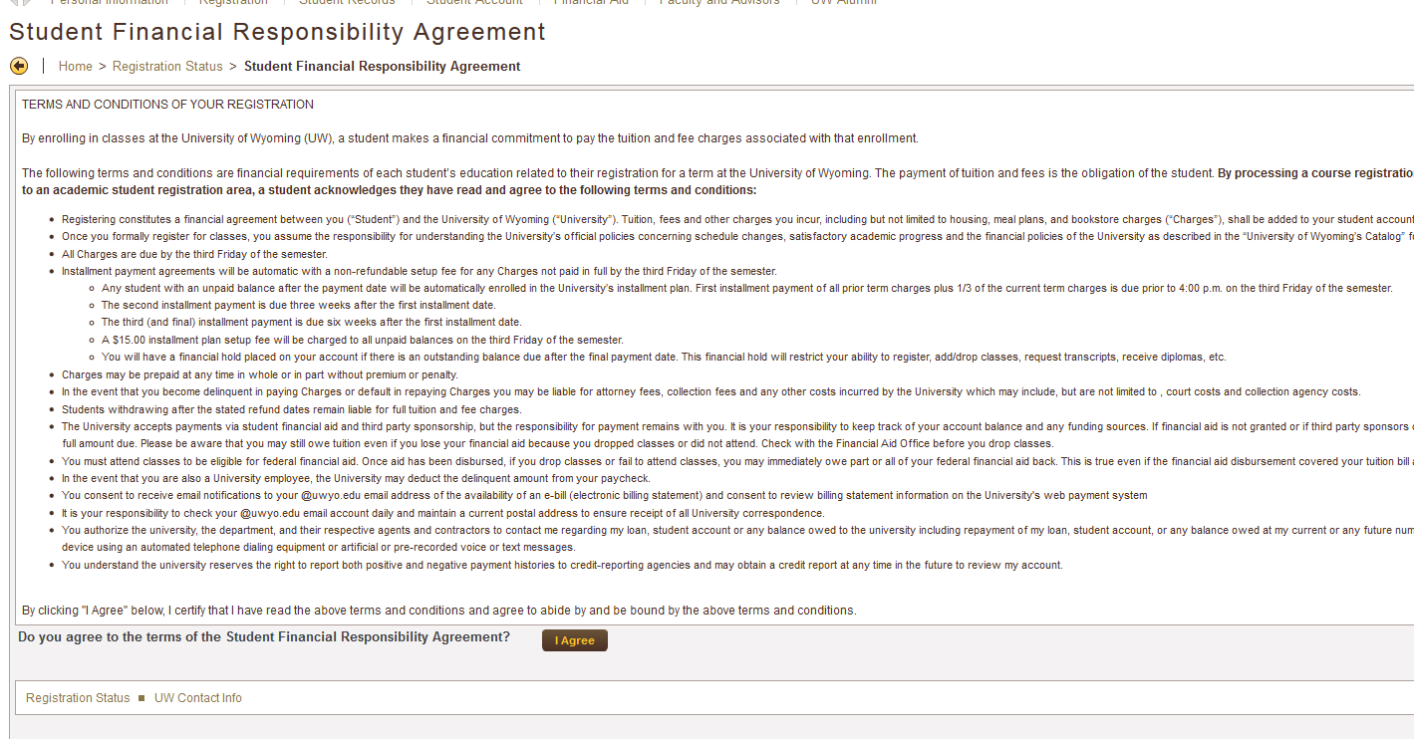
Click on Student Financial Responsibility Agreement
Read through the agreement and then click “I Agree”.

Slide 9
Once all Registration Status items have been completed and have green check marks next to them you can proceed to Registration by clicking the link “Register for Classes”.

Slide 10
You’ll be directed to this landing page. Choose Register for Classes. You may be prompted again to choose a role.

Slide 11
Select a Term Open for Registration from the drop down menu
There are 2 ways to search and register for courses. If you know the CRN number choose that option.
Find Classes Enter CRNs

Slide 12
Using Advanced Search
Advanced Search allows you to search for courses using a variety of filters.
The example on the right is a search using the Attribute filter. By selecting one of these attributes you could search for courses that meet specific University Studies Program (USP Requirements).

Slide 13
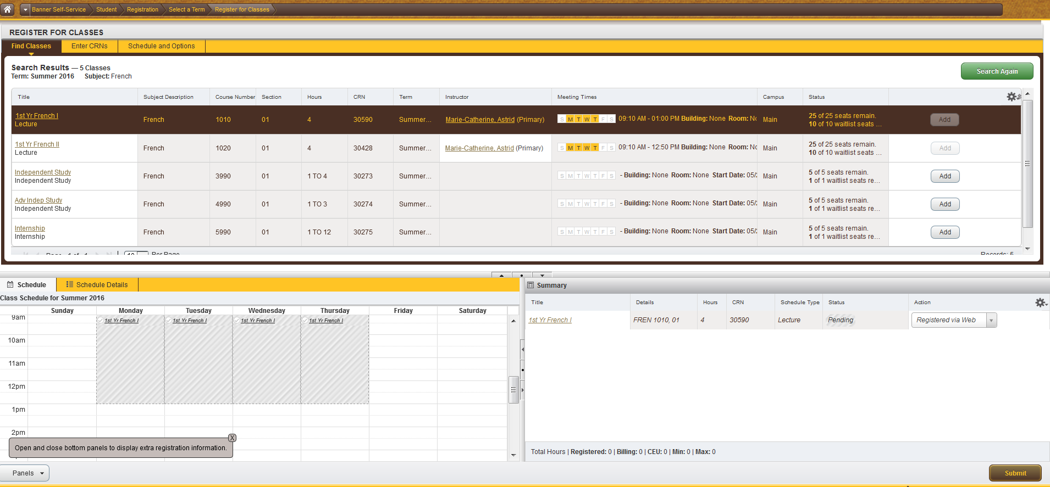
The Register for Classes screen will display three panels. These are outlined in red below. Search Results will be on the top, the schedule on the left and the Summary panel on the bottom right.
Once you find a course you’d like to enroll in click the Add button for the course. This adds the course to your Summary panel. You are not fully registered in a course until you hit Submit and the Status column changes to Registered.

Slide 14
Summary panel The Summary panel lists your registration information. There are several columns; Title, Details, Hours, CRN, Schedule Type, Status, and Action. Status indicates your actual enrollment status in the course. A status of Registered indicates successful registration. Action is a drop down menu with further registration options/actions available to you. Once you select an option from the Action column you must hit Submit to take that action.

Slide 15
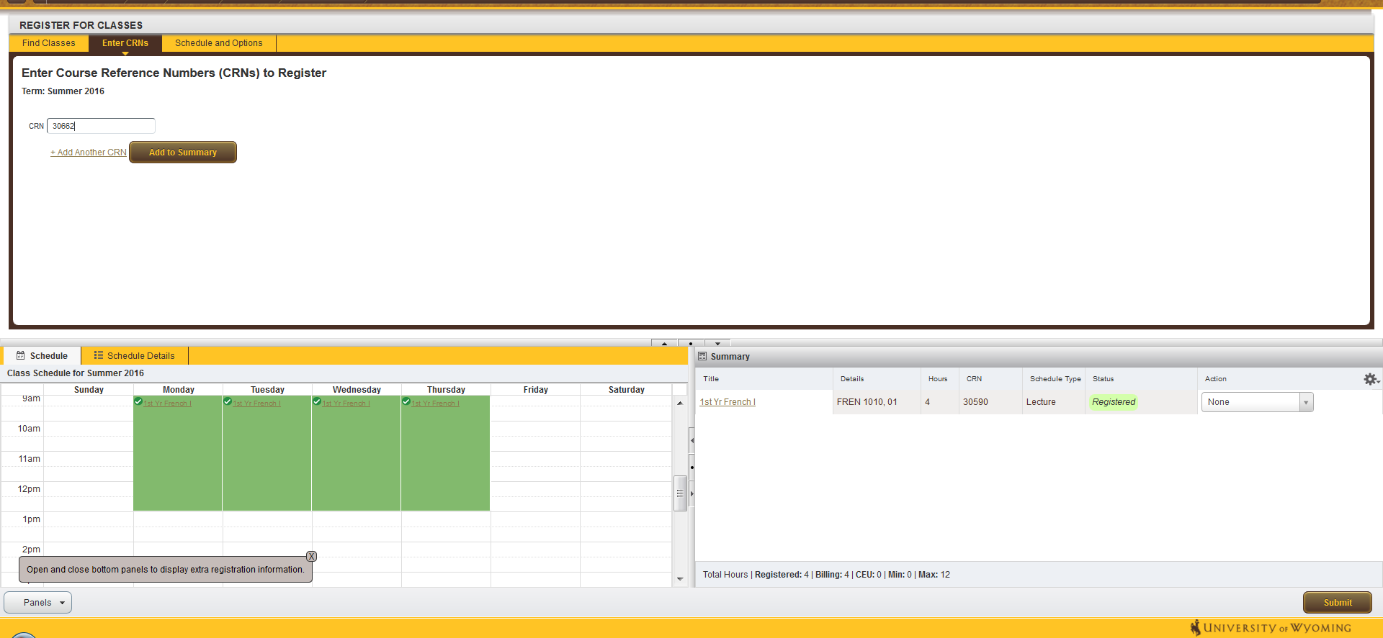
Enter CRNs You can also add courses be entering the CRNs. Enter the CRN and click Add to Summary. The course will appear in the Summary panel with the Status of Pending and the Action Registered via Web. Registration is not complete until you hit Submit. If Registration is successful the Status will changed to Registered.

Slide 16
Registration Errors If you encounter errors when attempting to register they will display in the Status column and in a notification on the top right of the screen.

Slide 17
To drop a course select Drop via Web from the Action column and then hit Submit. Successful drop will display as Deleted.

Slide 18
Wait List If a course is closed/full, but has a waitlist you’ll receive a notification. In this example GEOG 1010 is Closed and there are 0 students currently waitlisted.
To add yourself to the Waitlist, choose Wait Listed from the Action Column menu and hit Submit.
The Status column indicates Waitlisted when you are successfully on the Wait List.

Slide 19
Linked Classes Some courses are linked together, meaning that registration in both components is required. In this example a Lecture and a Lab are linked. View Linked will display search results for each combination of linked courses.
There could be a long list of combinations displayed in the when you click View Linked. If you find a combination you’d like to enroll in, click Add all

Slide 20
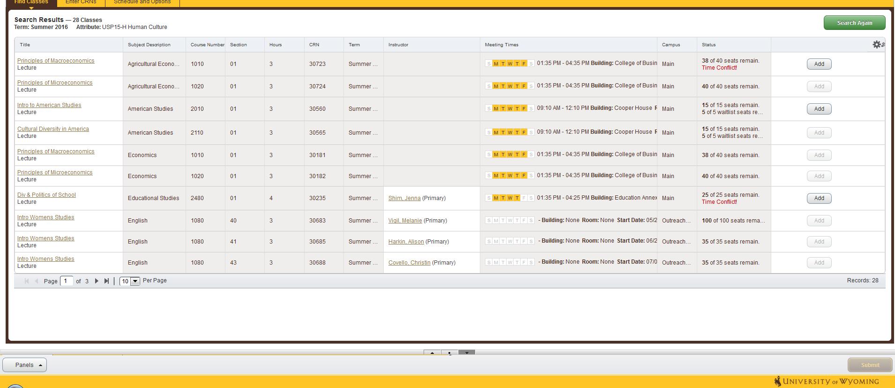
Display options If your Search Results yield a high number of courses you may want to view that panel alone. You can control how the panels display through the small arrow and circle icons in grey. You may also choose to display more results on the page through h the Per Page drop down menu.

Slide 21
Class Details Course titles are also hyperlinks. When you click on a course title another window will appear with class details, including a link to the Bookstore with information about required materials.

Slide 22
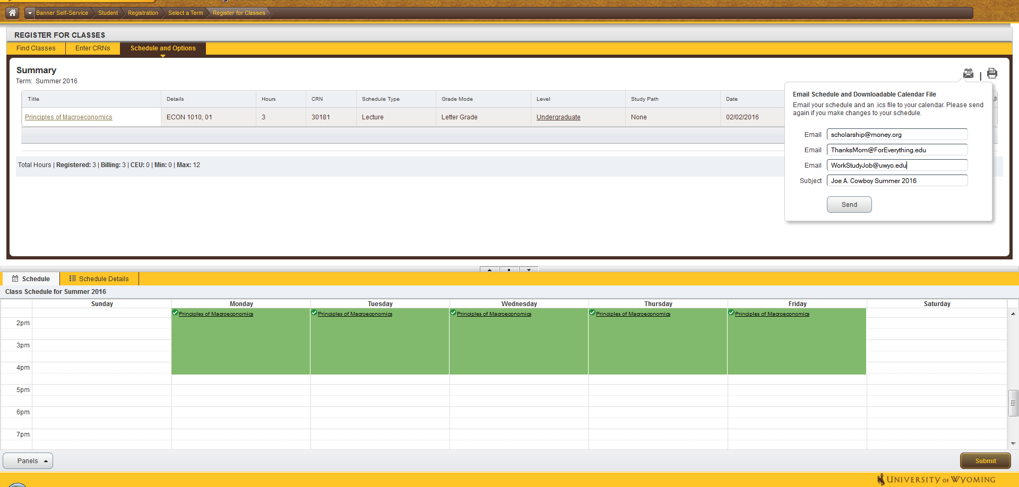
Schedule and Options Once you’ve registered you may want to review your schedule. Under the Schedule and Options tab you can view different versions of your class schedule, print your schedule, and send it to an email address. *Email Schedule and Downloadable Calendar File This new feature allows students to email their class schedule along with a downloadable calendar file.

Slide 23
Questions?
For additional assistance with Registration contact the Office of the Registrar
registrar@uwyo.edu
307-766-3137

